Slide 1
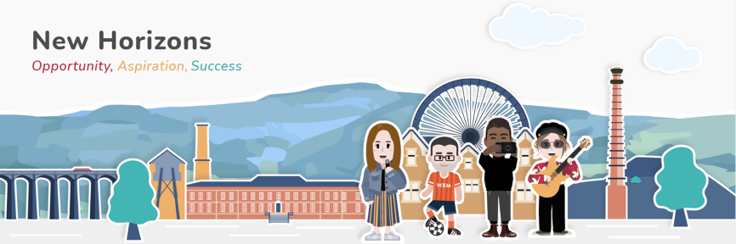

Gorwelion Newydd
Curriculum Statement

Slide 2

Vision and overall purpose
Our Curriculum is at the heart of everything we do at Gorwelion Newydd. It is centered around the needs of our pupils and is designed to provide opportunity and develop aspiration that leads to success.
The curriculum is built around the needs of our pupils and has three pillars of safety, skills and sustainability.
We aim to:
Provide a broad, diverse and balanced curriculum that values and recognises individual learning needs and the success that is relative to a personal development journey.
Develop, apply and teach skills that are important for our pupils to become independent, safe, resilient and responsible citizens of our local and wider community.
Ensure our high aspirations contribute to a sustainable passion for learning and personal development that will support key stages of transition in either education, training or employment.

Slide 3


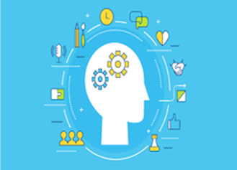



The foundations of our curriculum are the three pillars of safety, skills and sustainability.
Safety Skills Sustainability

Slide 4


GORWELION NEWYDD - NEW HORIZONS
SAFETY PILLAR
The safety and well being of our pupils are paramount.
Safety refers to:
Physical safety
Emotional safety
All our pupils at Gorwelion Newydd are taught how to be healthy and safe . We do this to ensure that our pupils can enjoy learning, achieve, make a positive contribution and gain the skills and knowledge to achieve economic well-being.
Strategies for our pupils to develop a safe and healthy approach to education include:
Understanding the current physical and emotional risks and plan accordingly.
Making our practices, policies and procedures (relating to safety and well being), part of our everyday culture.
Ensuring pupils have access to appropriate support for their psychological and physical well-being.
Involving and engaging with parents and stakeholders.
Ensuring our pupils are equipped with the knowledge and skills of how to stay safe and healthy.
KEY WORDS
Physical Health – pupils are encouraged to develop all the factors that promote good physical health and well being.
Experiences – pupils are provided with knowledge and strategies that allow them to respond in a way that has a positive impact on their mental health and emotional well being.
Decisions – pupils understand how decisions they make impact on their own safety and well being, as well as that of others.
Surroundings - Pupils are taught, and understand the importance of, social influences e.g. rules and attitudes and how these impact on their safety, health and well being.

Slide 5


GORWELION NEWYDD - NEW HORIZONS
SKILLS PILLAR
Pupils need to access a curriculum that regularly reinforces the cross-curricular skills of literacy, numeracy and digital competence and that provides opportunities to practise them.
This means employing a blend of approaches including those that promote problem-solving, creativity and critical thinking. We encourage our pupils to take increasing responsibility for their own learning.
Pupils need to develop these skills to support transition into future education, employment or training.
Strategies for our pupils to develop skills for life include:
Ensuring that skills progression is incorporated into curriculum planning.
Ensuring that skills are developed which are suitable for differing ages, abilities and aptitudes.
Ensuring that pupils acquire knowledge and skills about human rights and the sources of those rights.
Ensuring our pupils learn to develop communication and social interaction skills.
Ensuring our pupils learn to develop entrepreneurial and vocational skills.
KEY WORDS
Communication skills.
Social and emotional skills.
Numeracy, literacy and digital skills.
Critical thinking and problem-solving.
Agility and adaptability.
Initiative and entrepreneurialism.
Accessing and analysing information.
Curiosity and imagination.

Slide 6


GORWELION NEWYDD - NEW HORIZONS
SUSTAINABILITY PILLAR
Pupils need to understand that our actions today can have implications on the lives of future generations. The emphasis on sustainability in our curriculum needs to help pupils develop their knowledge, skills, values and behaviours for them to become responsible citizens by ensuring a balance between economic growth, environmental care and social well-being.
Our aim is for our pupils to be able to resolve challenges, respect cultural diversity and therefore contribute to creating a better community.
KEY WORDS
Sustainable – Sustainability consists of fulfilling the needs of current generations without compromising the needs of future generations, while ensuring a balance between economic growth, environmental care and social well-being.
Environment - the immediate surroundings in which people live, or the natural world such as the land, air or water.
Finite - something that has a limited number of uses before it ends.
Implement - to put into effect or accomplish.
Materials – a substance from which something is made or can be made.
Replenish - to replace or fill something back up again.
Resource – physical material that is useful to people.
Technology - knowledge or equipment to achieve a task or goal.
Strategies for our pupils to develop a sustainable approach to education include:
Encouraging and fostering resilience.
Conserving resources.
Using locally sourced materials.
Involving and engaging with local people and communities.
Using appropriate technology.
Developing skills and knowledge for life long learning.

Slide 7

PEDAGOGICAL PRINCIPLES
Our curriculum is underpinned by pedagogical principles, which state that good learning and teaching will:
Maintain a consistent focus on the overall purposes of the curriculum.
Challenge all learners by encouraging them to recognise the importance of sustained effort in meeting expectations that are high but achievable for them.
Mean employing a blend of approaches including direct teaching.
Mean employing a blend of approaches including those that promote problem-solving, creativity and critical thinking.
Set tasks and select resources that build on previous knowledge and experience and engage interest.
Creates authentic contexts for learning.
Mean employing assessment for learning principles.
Range within and across areas.
Regularly reinforce the cross-curricular skills of literacy, numeracy and digital competence, and provide opportunities to practise them.
Encourage learners to take increasing responsibility for their own learning.
Support social and emotional development and positive relationships.
Encourages collaboration.

Slide 8

Our curriculum is designed to ensure that our pupils become:
Ambitious, capable learners ready to learn throughout their lives.
Enterprising, creative contributors, ready to play a full part in life and work.
Ethically informed citizens of Wales and the world.
Healthy, confident individuals, ready to lead fulfilling lives as valued members of society.

Slide 9

At Gorwelion Newydd we want to create ambitious, capable learners who are ready to learn throughout their lives.
We do this by ensuring that:
Pupils develop a love for learning and understand its purpose.
  Pupils make clear choices that have a positive impact on their learning.
    Pupils are engaged in a relevant, differentiated and appropriate curriculum.
      Pupils understand school expectations.
        Pupils develop and display resilience when things get difficult, or don’t go their way.
          Pupils can confidently display their skills and achievements.
            Pupils achieve a level of literacy, numeracy and digital competency that enables them to progress in life independently and as safely as possible.
              Pupils can successfully transition back to school, or into college or work.

Slide 10

At Gorwelion Newydd we want pupils to be enterprising and creative contributors who are ready to play a full part in life and work.
We do this by ensuring that:
Pupils engage in pupil-voice activities to have their say in the school community.
Pupils play a positive role in their local community by using community facilities and engaging in community projects.
Pupils channel their imagination into practical, creative opportunities to make the world around them a better place.
Pupils develop entrepreneurial and vocational skills that can be applied now, and in the future.
Pupils develop a mindset that encourages curiosity and a willingness to participate and engage in new experiences.

Slide 11
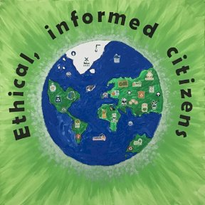
At Gorwelion Newydd we want pupils to become ethical and informed citizens of Wales and the world.
We do this by ensuring that:
Pupils learn about social norms and expectations.
Pupils express their own opinions through pupil voice forums.
Pupils take lead roles in different activities and events.
Pupils take an active role in keeping themselves safe.
Pupils share experiences of their own cultures and traditions with their peers.
Pupils develop their understanding of a sense of place; in school, in Wrexham, in Wales and in the wider world.
Pupils engage in activities and learning that celebrates different cultures and customs from around the world.

Slide 12
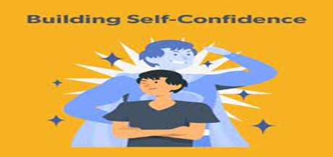
At Gorwelion Newydd we want pupils to become healthy, confident individuals who are ready to lead fulfilling lives as valued members of society.
We do this by ensuring that:
Pupils develop healthy, positive relationships with their peers and staff.
Pupils eat and drink healthily and can organise and prepare healthy meals and snacks.
Pupils engage in a range of physical activities both in school and off site.
Pupils understand the impact their own actions have on what happens to themselves, others and their surroundings.
Pupils develop a clear understanding of right and wrong.
Pupils express their own views and opinions in a confident and thoughtful manner.
Pupils can make clear choices based on skills and knowledge developed.
Pupils take an active role in keeping themselves safe.

Slide 13
KS3 Overview
In accordance with Welsh Government Curriculum for Wales framework, Gorwelion Newydd will provide learning:
that enables learners to develop in relation to the four purposes.
which is suitable for learners of differing ages, abilities and aptitudes.
which is broad and balanced, and offers appropriate progression.
which includes learning that develops cross-curricular skills.
which encompasses the Health and Well-being area of learning and experience.
which encompasses Relationships and Sexuality Education – RSE that is developmentally appropriate for each learner.
Our aim is to provide as broad and balanced a curriculum as possible, which includes the other areas of learning and experience (Expressive Arts, Humanities, Languages, Literacy and Communication, Maths and Numeracy, Science and Technology).
The key stage 3 curriculum is organised into three annual cycles and broadly delivered through a thematic / topic based approach. The emphasis will be on creativity that supports innovation of an exciting and dynamic curriculum. Pupil have been consulted on our topic / curriculum design. A collaborative approach is adopted to enhance the delivery of our curriculum e.g. Eco Schools, School Nurses, North Wales Police, Info Shop, Spectrum Project, Proud Trust.
Examples of our topics include:
Welsh Castles; Wexham FC; Welsh Language; History of Wrexham; Wrexham Ghosts and Legends; Artificial Intelligence; Homes of the Future; The World of Social Media; The World of Film; Changing Trends in Shopping; Crime and Punishment; War; Different Cultures; The World of Books; Fast Food v Healthy Food; The Physical World; Life in the Jungle; Wildlife and Sustainability; The World’s Great Cities; The Apprentice.
Pupils complete baseline assessments on entry to GN and are reassessed in accordance with our assessment cycle. These assessments include: reading, writing, numeracy, digital competence and PASS (Pupil Attitude to Self and School).
A termly progress report and a full annual report are completed for all pupils.

